Slide 1


Demand management
Vodafone case study
By
Ahmed Anwer

Slide 2
Contents
Introduction
Preprocessing
Reshaping
Analysis & visualization
Insights & conclusion

Slide 3
Introduction
The dataset represents a detailed information about employees at different location.
Data contains the contracted hours, allocated hours and the remaining hours for each employee grouped by month from the duration November 2021 to February 2023
Some locations counts the number of tasks for each employee and the type of the task

Slide 4
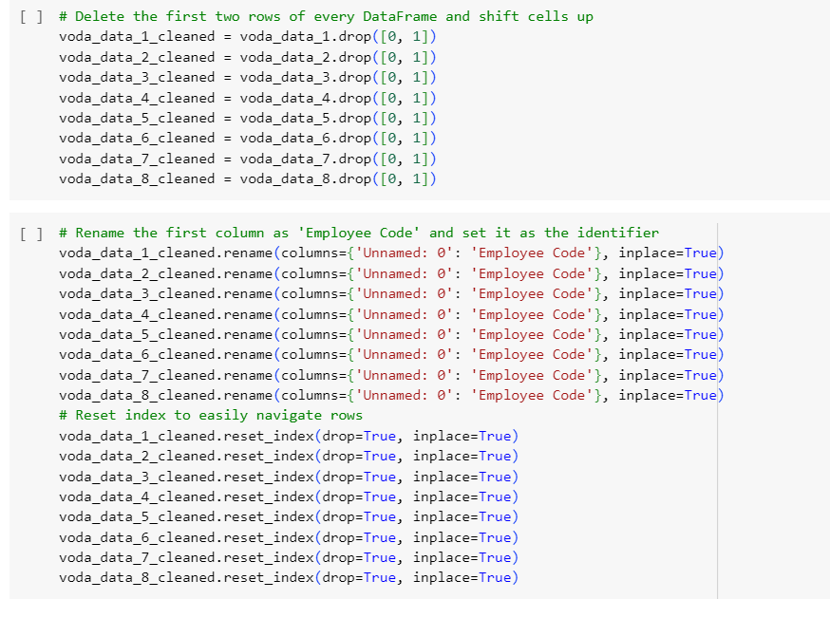
Preprocessing
Read every sheet individually
removing empty rows

Slide 5
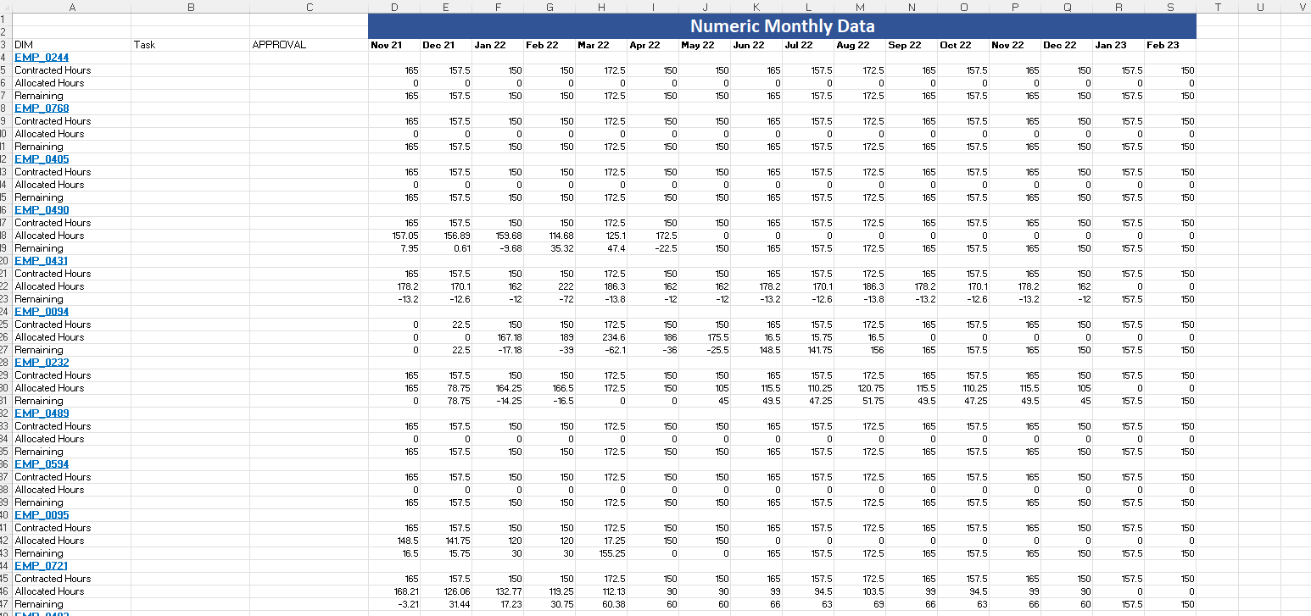
Reshaping
Data before reshaping was too messy

Slide 6
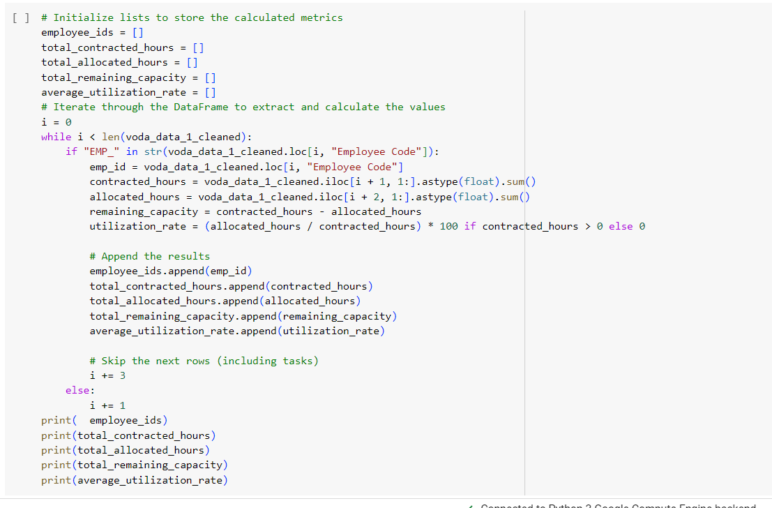
code used to reshape
Using python environment on Google-colap this is the code used to reshape the data sheet by sheet

Slide 7
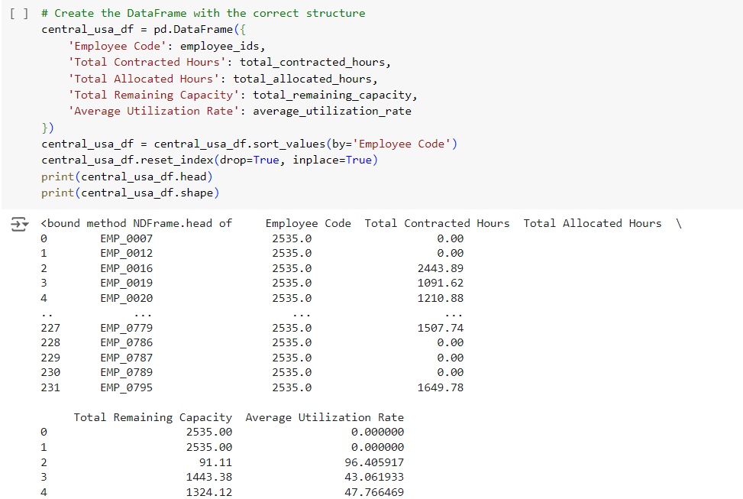
Making a new data frame for the reshaped sheet

Slide 8
READ THE RESULTS TO A NEW EXCEL FILE

Slide 9
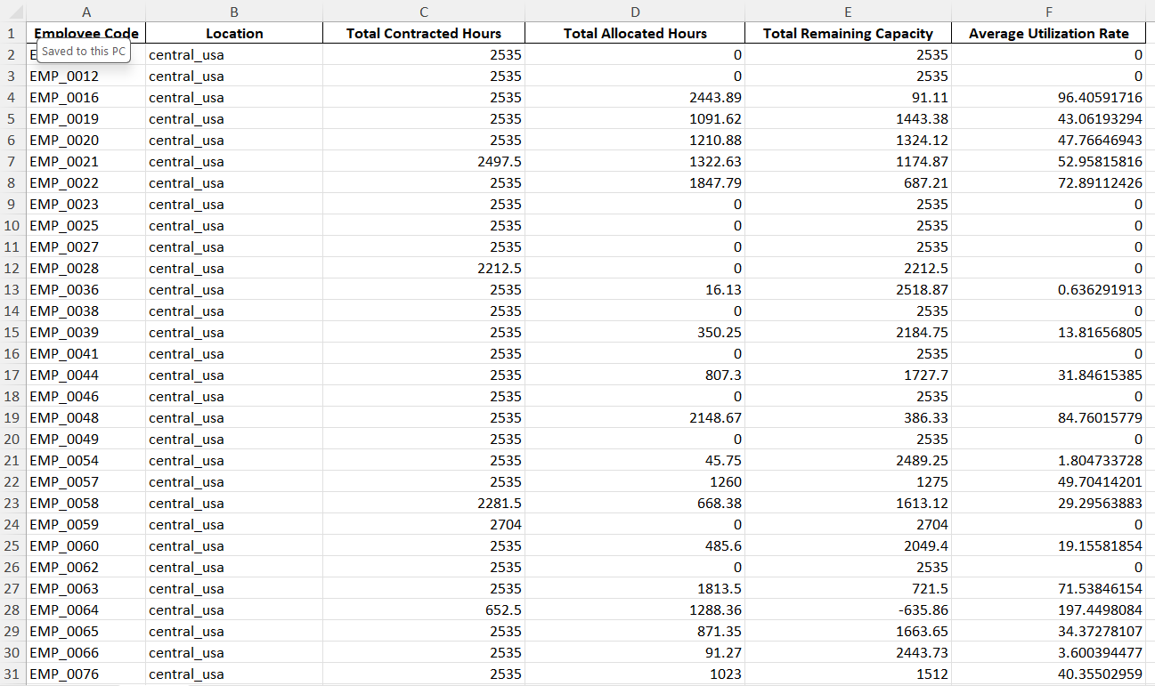
Data after reshape

Slide 10
Final data
Merged by excel functions and filters

Slide 11
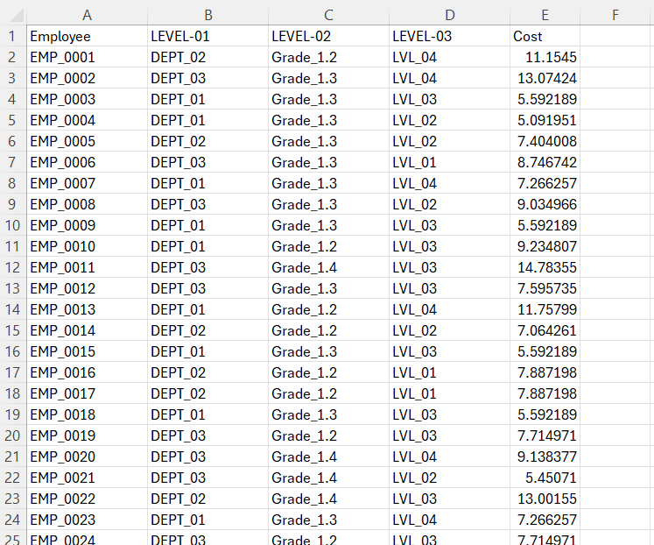
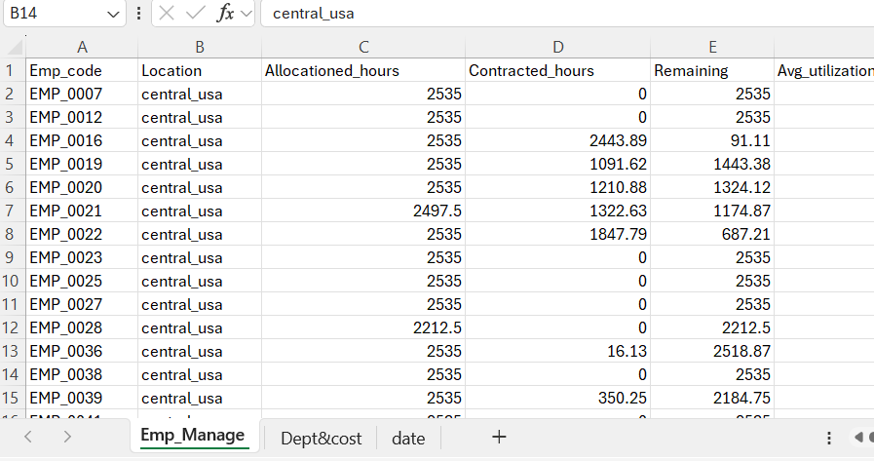
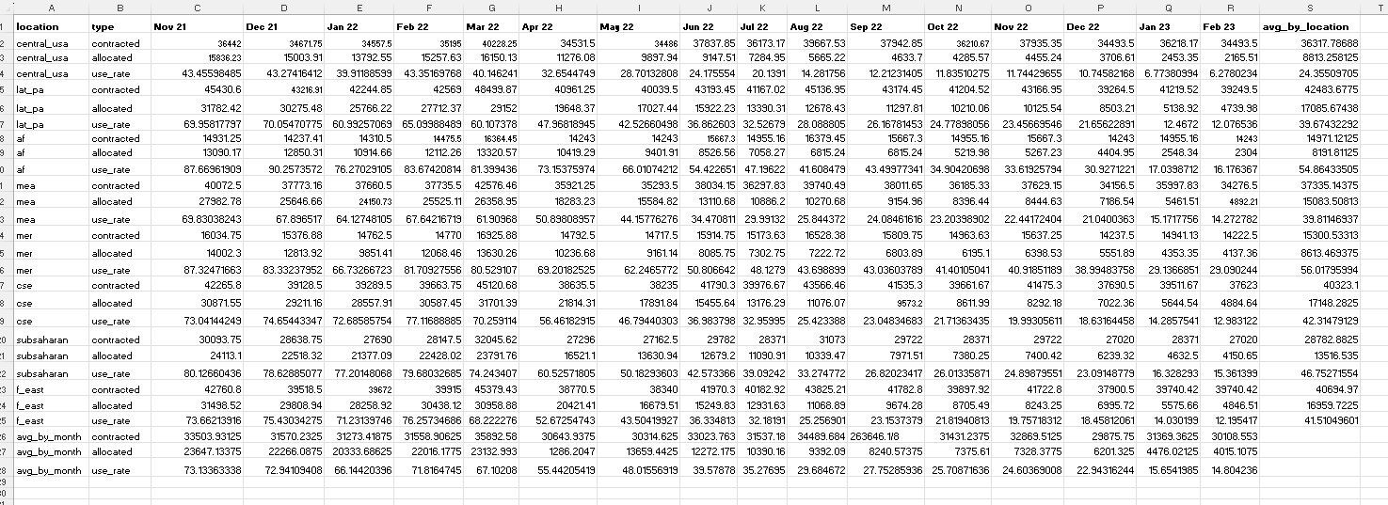

Slide 12
Analysis & visualization
Using power bi
python

Slide 13

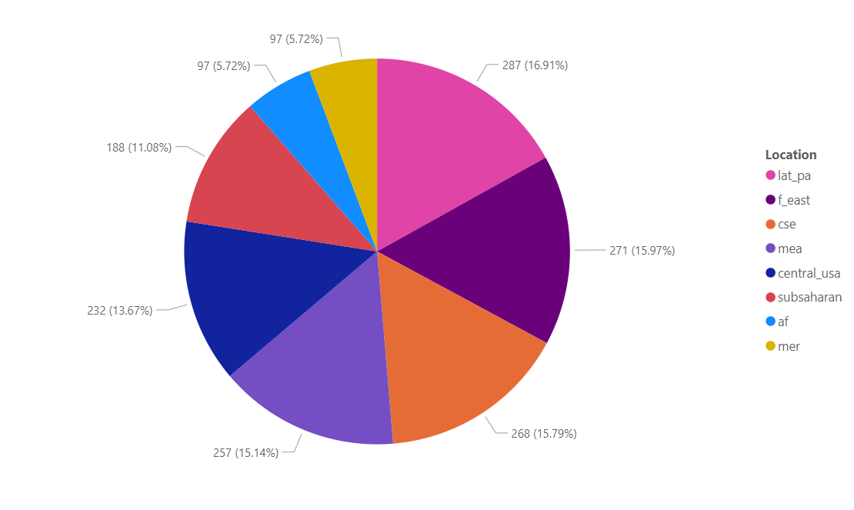
Number of employees per location

Slide 14
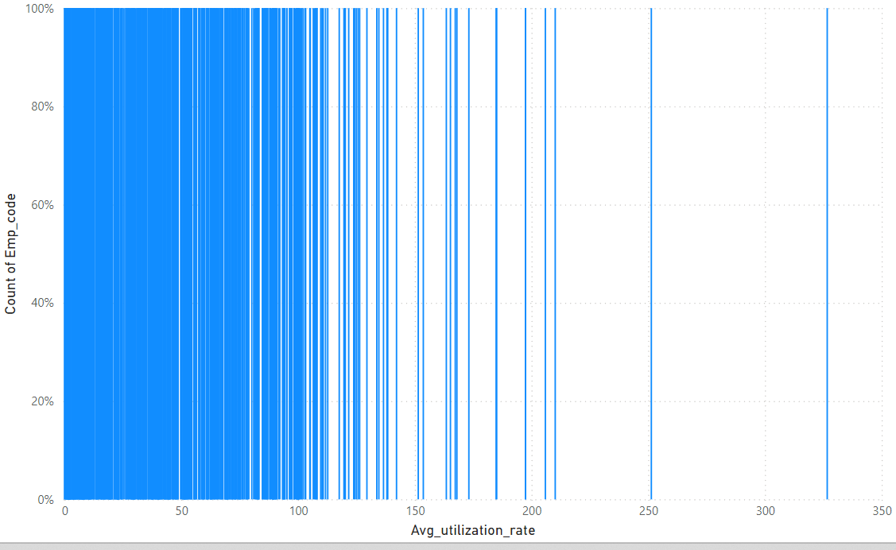
distribution of employees according to utilization rate

Slide 15
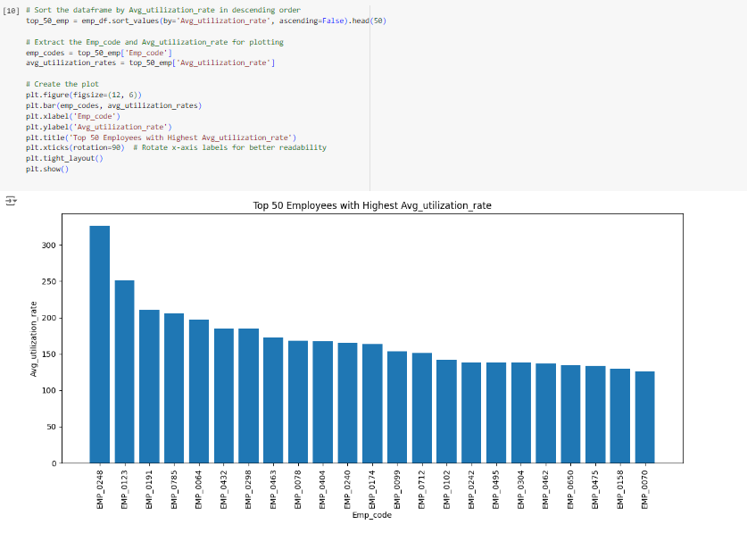
Top employees

Slide 16
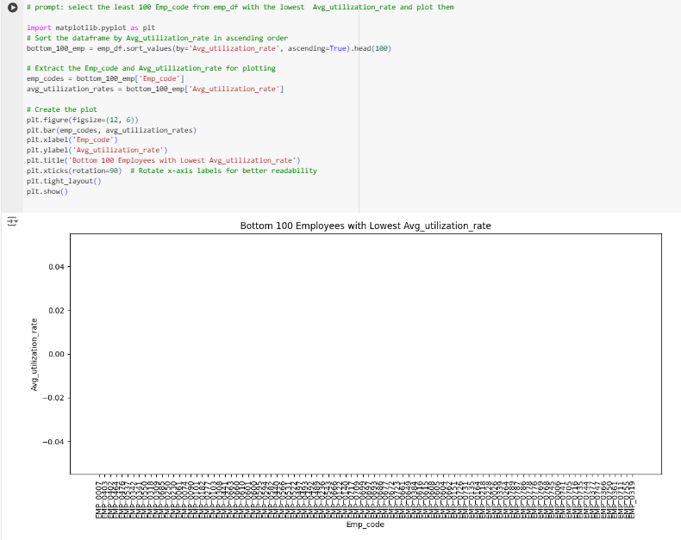
Least employees

Slide 17
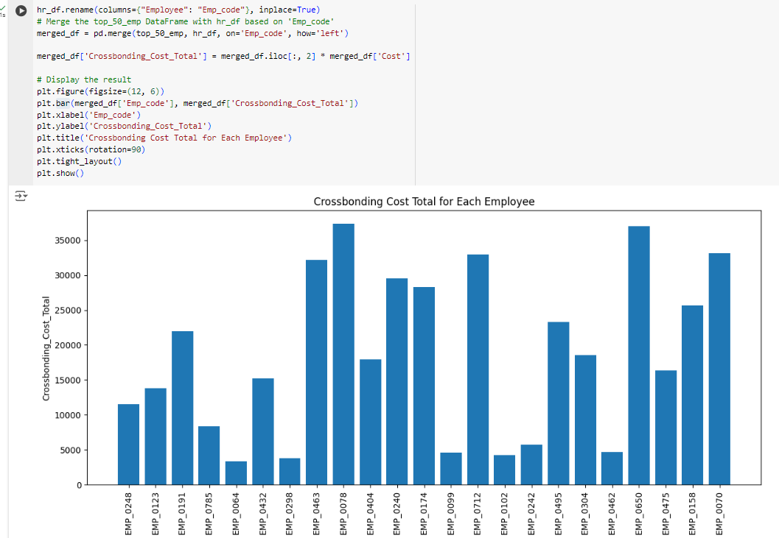
Cost of top 50

Slide 18
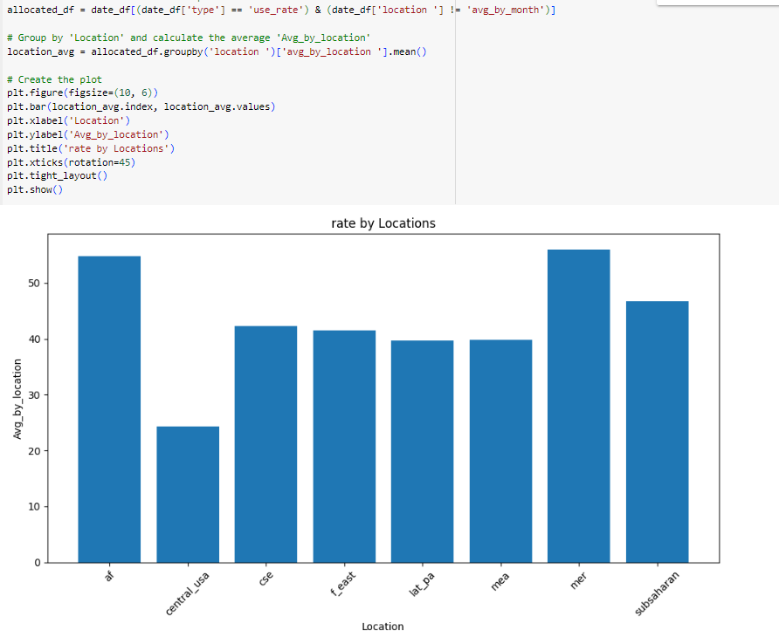
Avg use rate by location

Slide 19
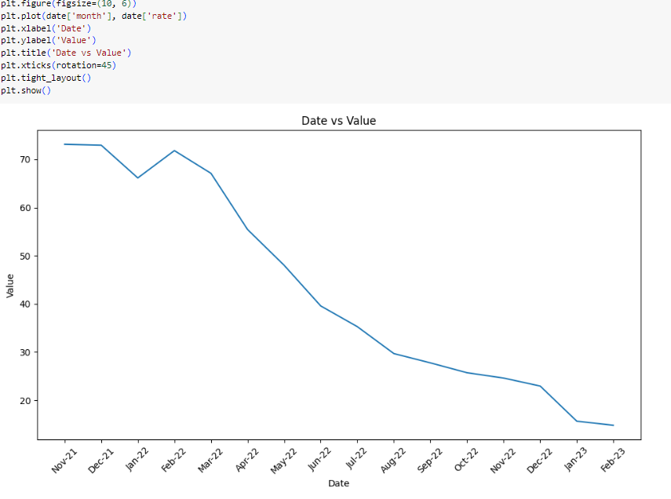
Avg utilization per month

Slide 20
Insights & conclusion
The company hires part time employees who are paid by hour (not determined either online or offline )
The number of allocated hours obviously started to decrease after feb 2022

Slide 21
The decrease of staffing could be according to some reasons like :
The unsatisfying payment (average 9.6$ per hour)
The trendy period was quite short which means employees didn’t find comfort in the job
The decrement started from feb-22 which the time the world started to get out of the quarantine and recovered from corona pandemic so perhaps employees lift their parttime jobs and got back to their original jobs

Slide 22
Thanks for listening

